Slide 1

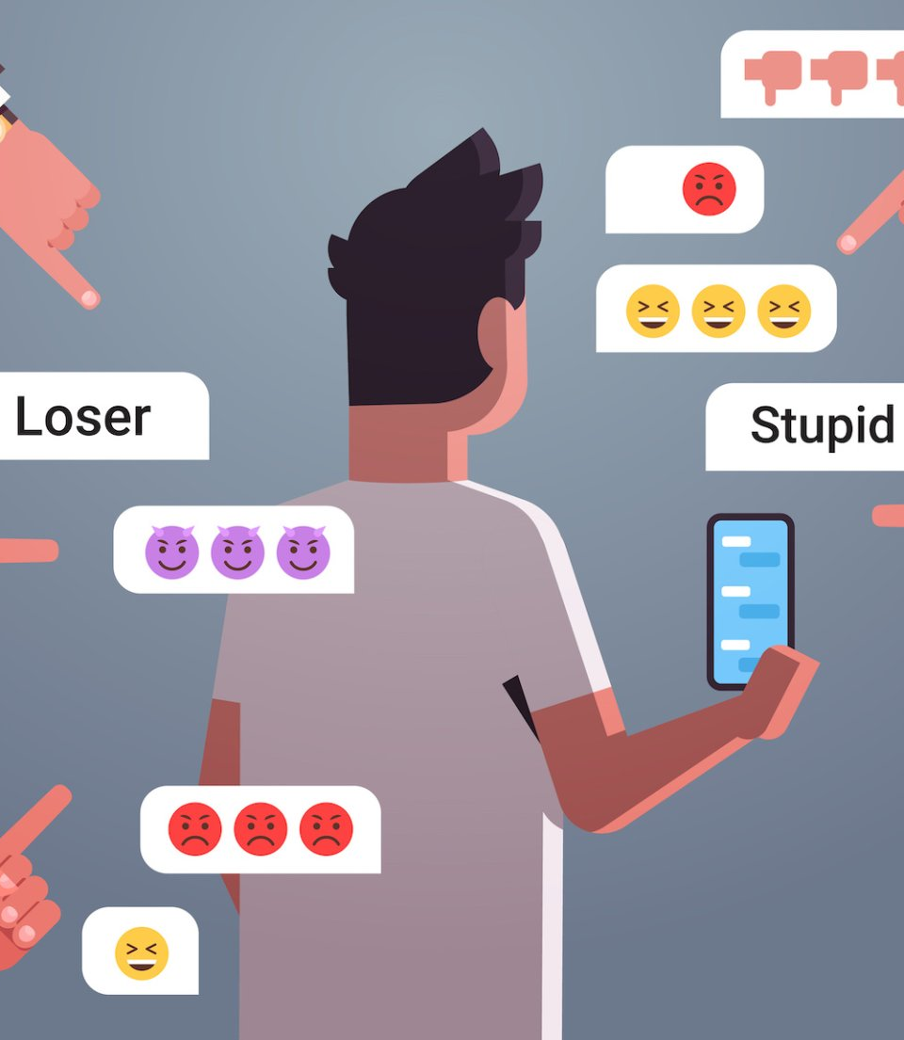

CYBER BULLYING
Shatarupa Ghosh
Prajwala Shambulingappa

Slide 2

Agenda
Introduction
Result Analysis
Motivation
Additional Analysis
Methodology

Slide 3

Motivation
Cyberbullying is a serious issue that affects many people, particularly youth, and can have long-lasting negative consequences. It is a serious problem that can have long-lasting negative impacts on the mental health and well-being of the victim, including anxiety, depression, and even suicidal thoughts. It can also lead to social isolation, academic difficulties, and decreased self-esteem. Empathy for the victim, social responsibility, understanding the legal consequences, and personal values such as kindness and respect can all serve as strong motivators to stop cyberbullying.

Slide 4
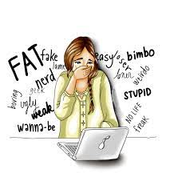

Introduction Almost every teenager around the world has been found to be a victim of cyberbullying in some way. Technologies that can automatically spot potential cyberbullying behaviors can be helpful in preventing harm to the victim. There are only a small amount of research on cyberbullying available, and it is even more difficult for harassed individuals to defend themselves as they lack the ability to recognize the bully. The advancement of a machine learning-based automatic cyberbullying detection system is a good solution to detect and remove sensitive data from social media posts.

Slide 5

Dataset
The dataset chosen for the project is a compilation of unique datasets relating to the automated identification of cyberbullying from various sources, such as Kaggle, Twitter, Wikipedia Talk pages, and YouTube. The data contains content that has been categorized as bullying or not, including hate speech, aggressiveness, insults, and toxicity.

Slide 6
Methodology This study explores multiple approaches to detect cyberbullying in text data. Where we have calculated the accuracy, F1 score, recall and precision. The counts of true positives (TP), false positives (FP), false negatives (FN), and true negatives (TN) are represented by the four cells in the confusion matrix. Approach 1: 1. Bag – of – Words Using a SVM classifier 2. Latent Semantic Analysis 3. Latent Semantic Analysis using Bag - of – Words 4. SVM classifier without the Bag - of - Words

Slide 7
Approach 2: BERT pretrained models 1. DistilBERT pretrained model (without fine tuning) 2. DistilBERT pretrained model (with fine tuning) 3. BERT-base pretrained model (without fine tuning) 4. BERT-base pretrained model (with fine tuning) 5. Roberta-base pretrained model (without fine tuning) 6. Roberta-base pretrained model (with fine tuning)

Slide 8
Result Analysis APPROACH 1
Entities | SVM with Bag-of-Words | Latent Semantic Analysis | Latent Semantic Analysis with Bag - of – Words | SVM classifier without the Bag - of - Words
Accuracy | 0.95306 | 0.90398 | 0.88473 | 0.90723
F1 Score | 0.95245 | 0.88532 | 0.89109 | 0.89109
Recall | 0.95306 | 0.90398 | 0.90723 | 0.90723
Precision | 0.95207 | 0.89641 | 0.8977 | 0.89977

Slide 9
APPROACH 2
Entities | DistilBERT pretrained model without fine tuning | DistilBERT pretrained model with fine tuning | BERT-base pretrained model without fine tuning | BERT-base pretrained model with fine tuning
Accuracy | 0.8656 | 0.9202 | 0.8781 | 0.9112
F1 Score | 0.4885 | 0.8522 | 0.5148 | 0.8354
Recall | 0.4978 | 0.8184 | 0.5248 | 0.7995
Precision | 0.4944 | 0.8985 | 0.9164 | 0.8868

Slide 10
Entities | Roberta-base pretrained model without fine tuning | Roberta-base pretrained model with fine tuning
Accuracy | 0.3435 | 0.9345
F1 Score | 0.1829 | 0.5731
Recall | 0.1601 | 0.5616
Precision | 0.2599 | 0.5865

Slide 11
ADDITIONAL ANALYSIS

Slide 12



WHICH IS BETTER?
Bag - of – Words (BoW)
It is a simple and efficient, making them useful for tasks such as text classification and information retrieval.
They also work well with smaller datasets and have a lower computational cost.
However, they ignore the context and order of words in the text, which can limit their effectiveness for tasks such as sentiment analysis or language translation.
Non Bag - of - Words (Non BoW)
It capture the context and meaning of words in the text and can provide better performance for tasks that require understanding the relationships between words.
They also work well with larger datasets and can handle more complex data.
However, they require more computational resources and can be more challenging to train and optimize.
Conclusion
The choice between a BoW or non-BoW approach depends on the specific task, the data available, and the trade-off between model complexity and performance.
In practice, it is common to try both approaches and compare their performance to determine the most suitable method for a given task.
It is also worth noting that there is ongoing research in developing hybrid approaches that combine the strengths of both BoW and non-BoW approaches.

Slide 13
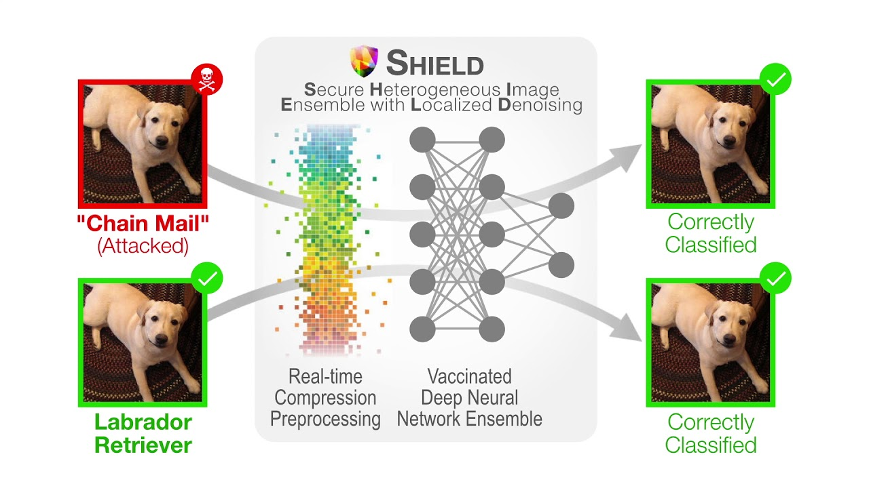
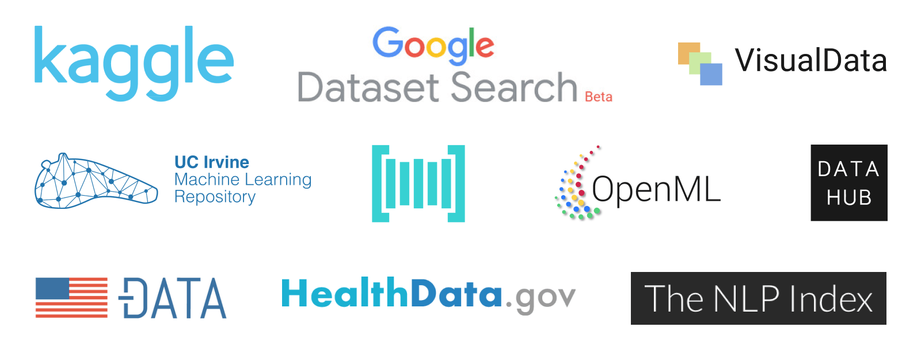


CHALLENGES
Adversarial Attacks
Lack of Annotated Data
Lack of Research
Complexity of Text Data

Slide 14
LEARNINGS
Understanding Which Approach is Better
Finding the Effective Dataset
Understanding Cyber Bullying
Understanding Bag-of-Words and Non Bag-of-Words Concepts
Finding the Ways to train the Models Accurately

Slide 15




Thank You!

